Slide 1
Winston Chiu_212668s
Phone used-Samsung J4+
Forgetful-A trip to the grocer without the shopping list, ends up with only snacks. Upon realization, running back out with the list to try to get the ingredients before lunch.
Ideation process- since my sister is lactose intolerant, she can only drink non-dairy milk alternatives, in this case soymilk. When my mother left to buy groceries with her, both of them forgot to buy soymilk, even though they wrote a list. “We both forgot about the list and left it in the bag”, both said after my sister came back with realization. Thus, I got inspiration and wrote this story. The snacks was just a comedic addon afterwards.

Slide 2
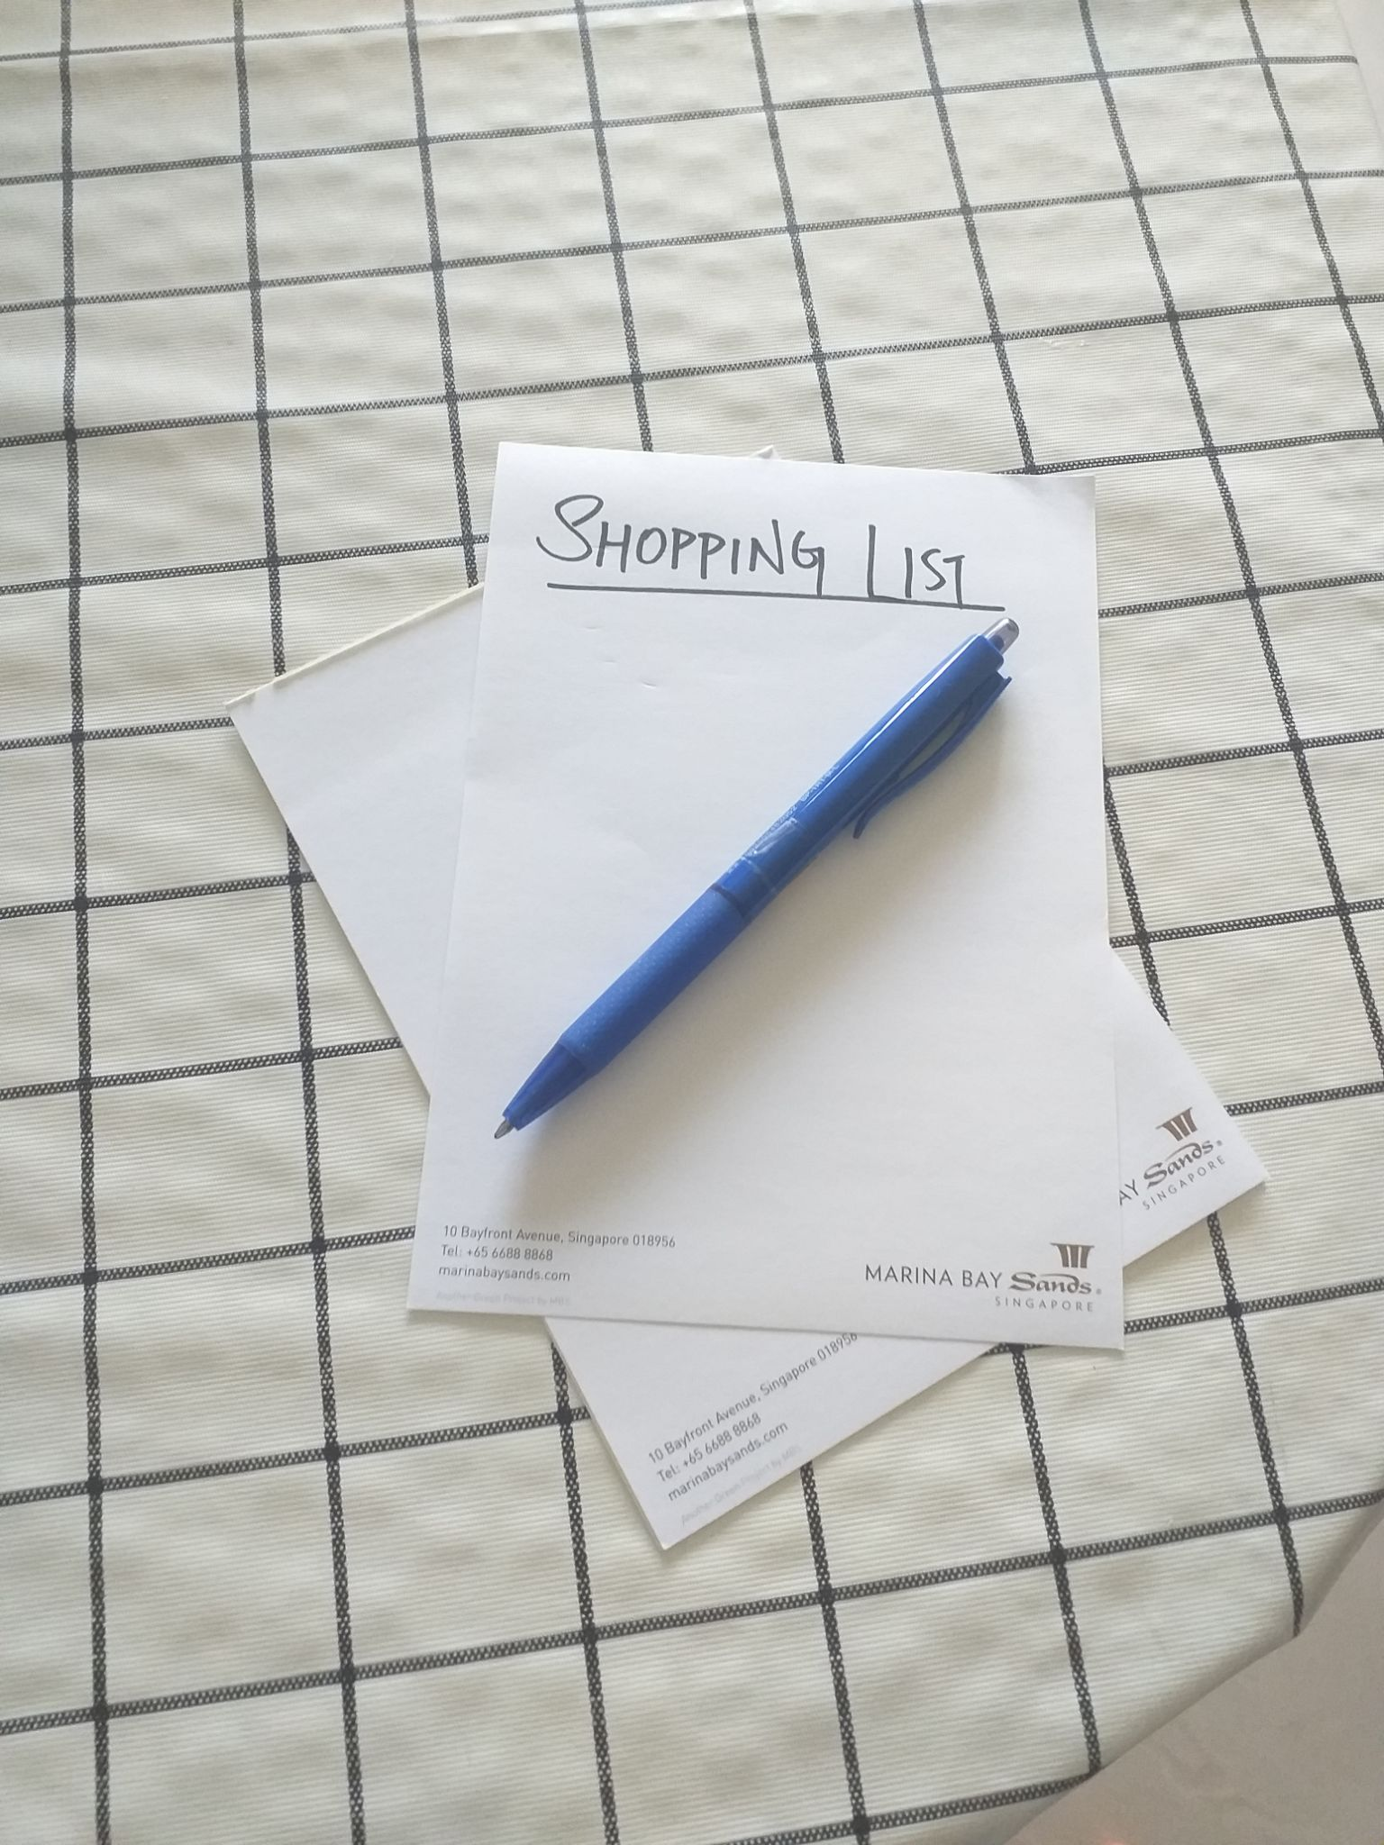

Slide 3
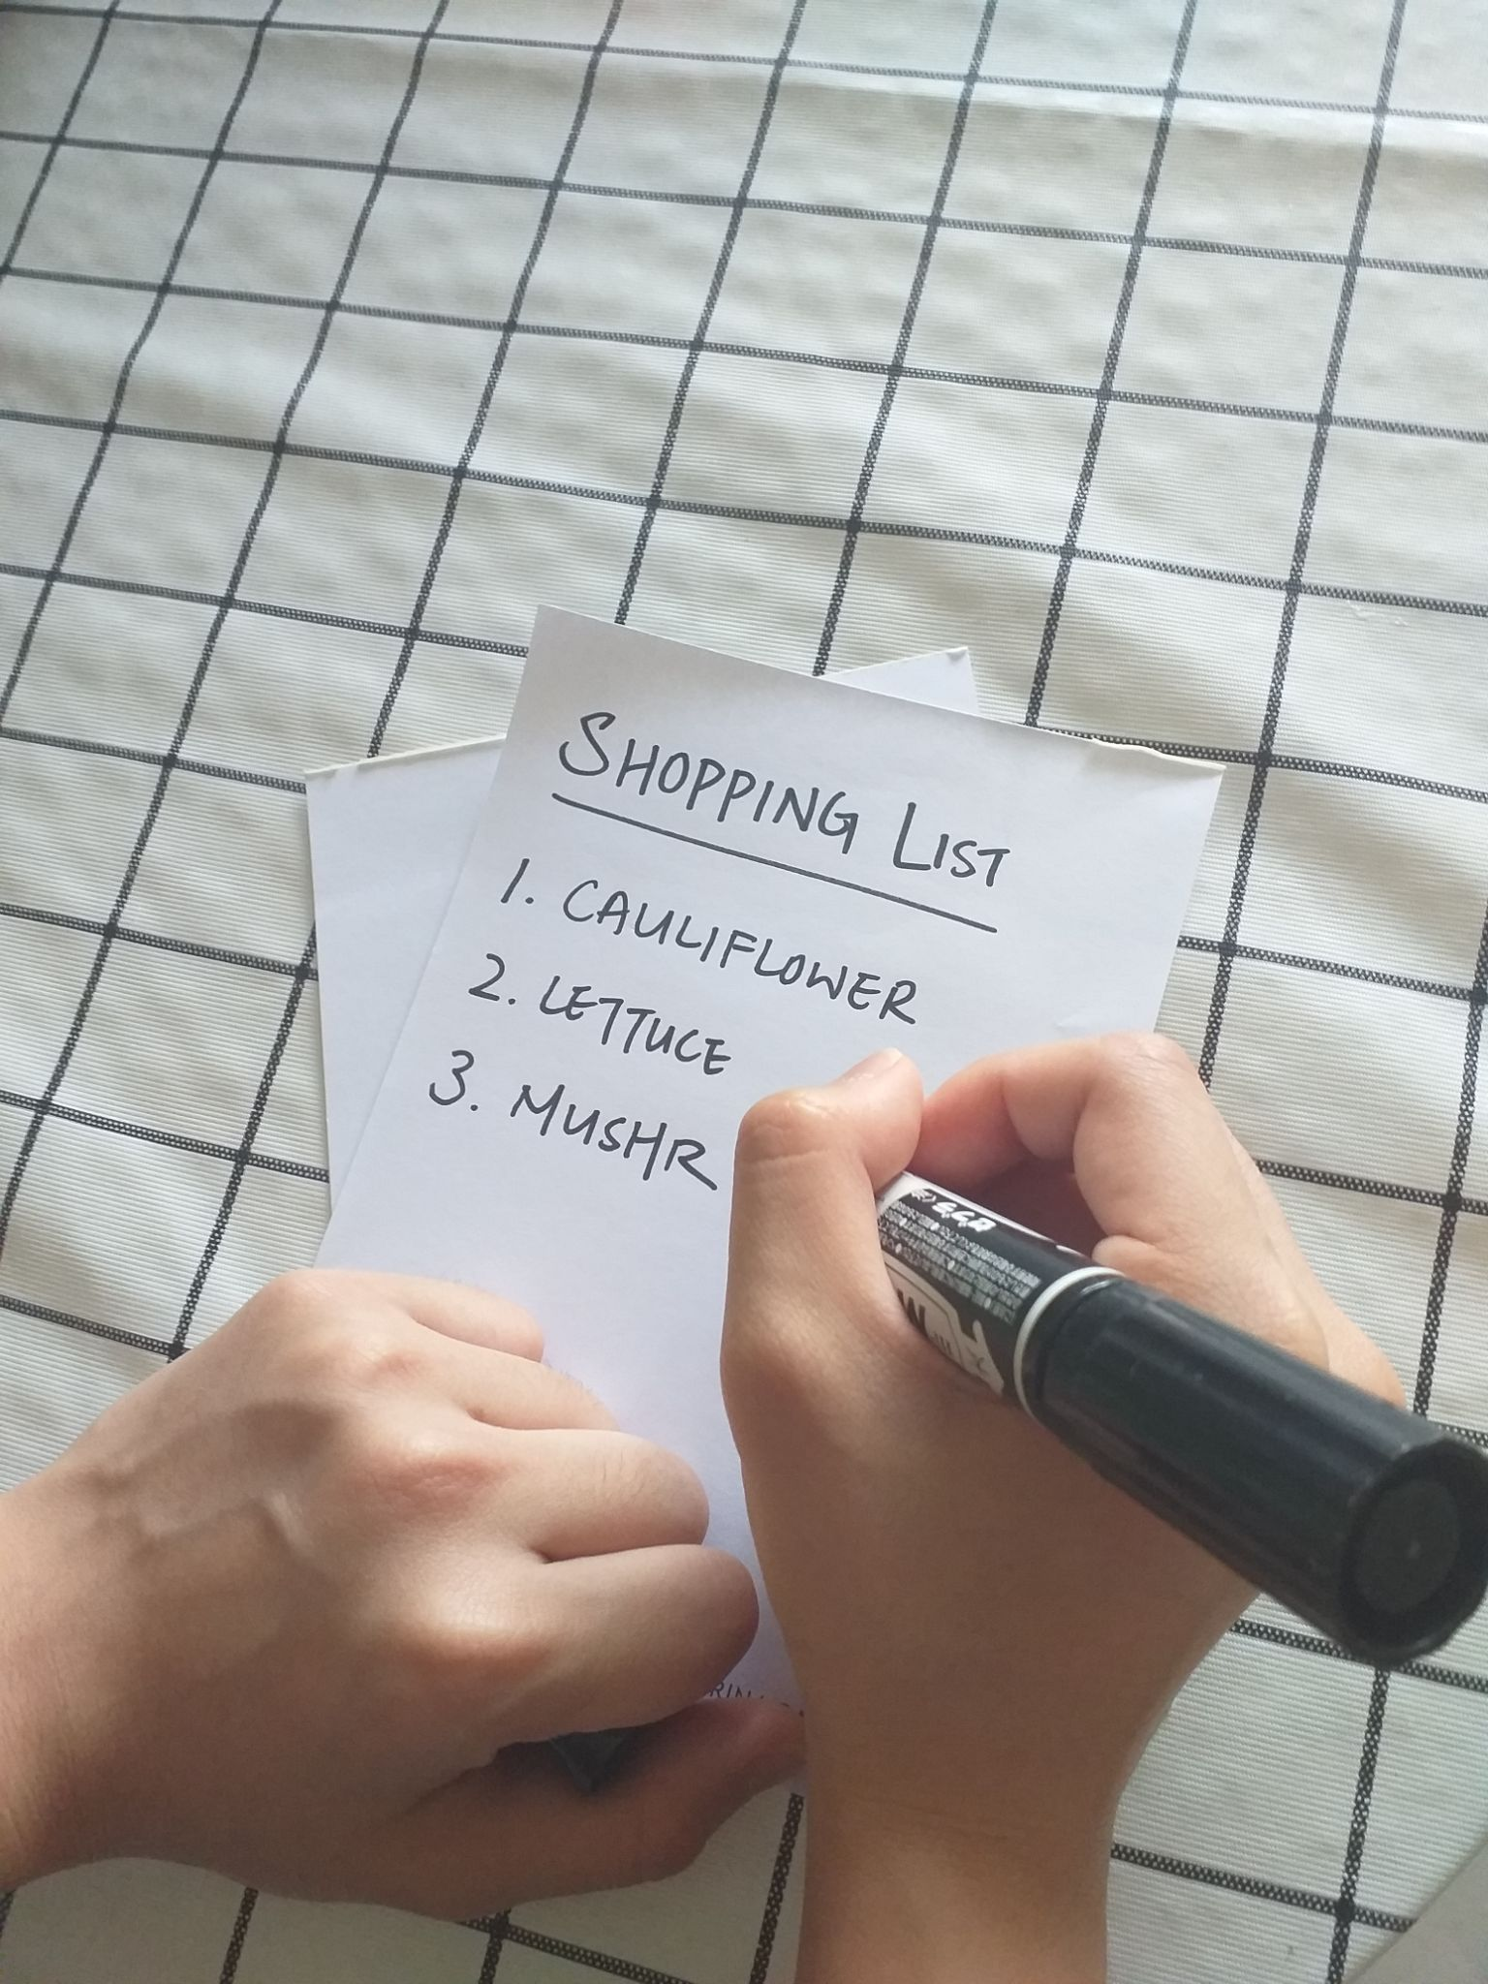

Slide 4
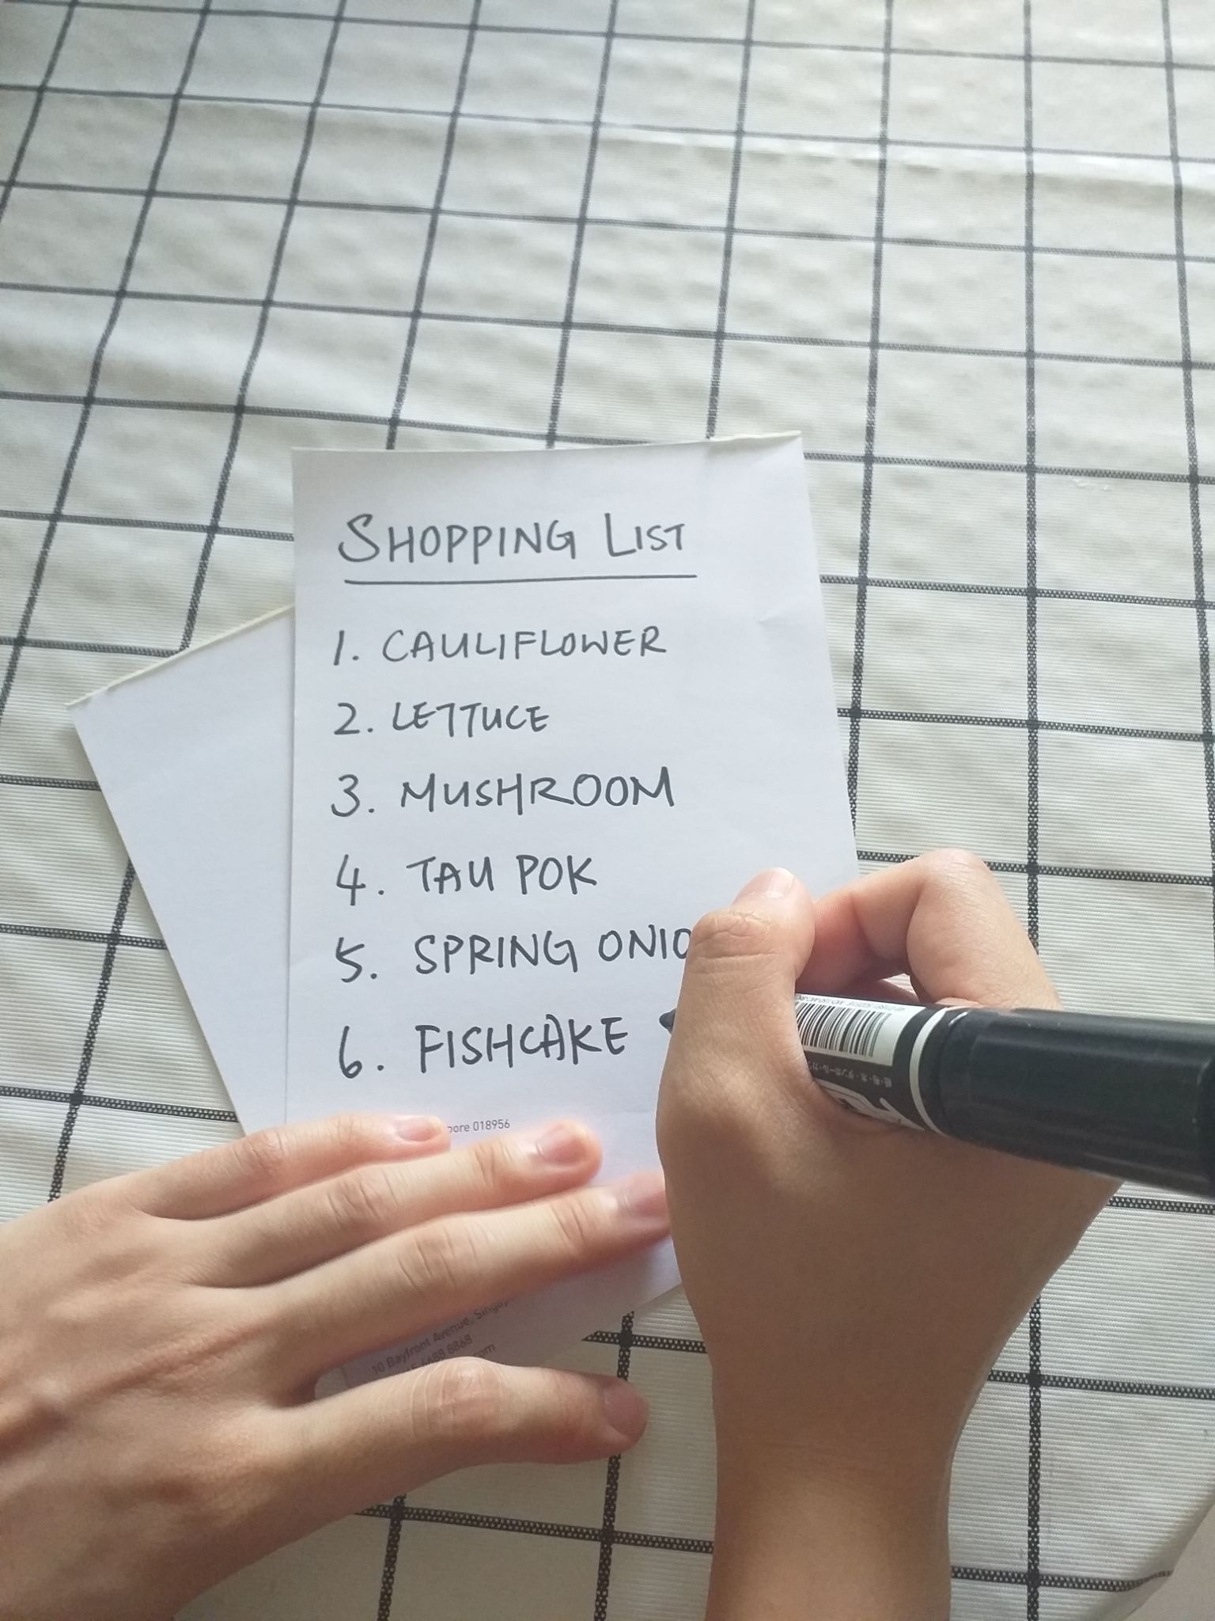

Slide 5
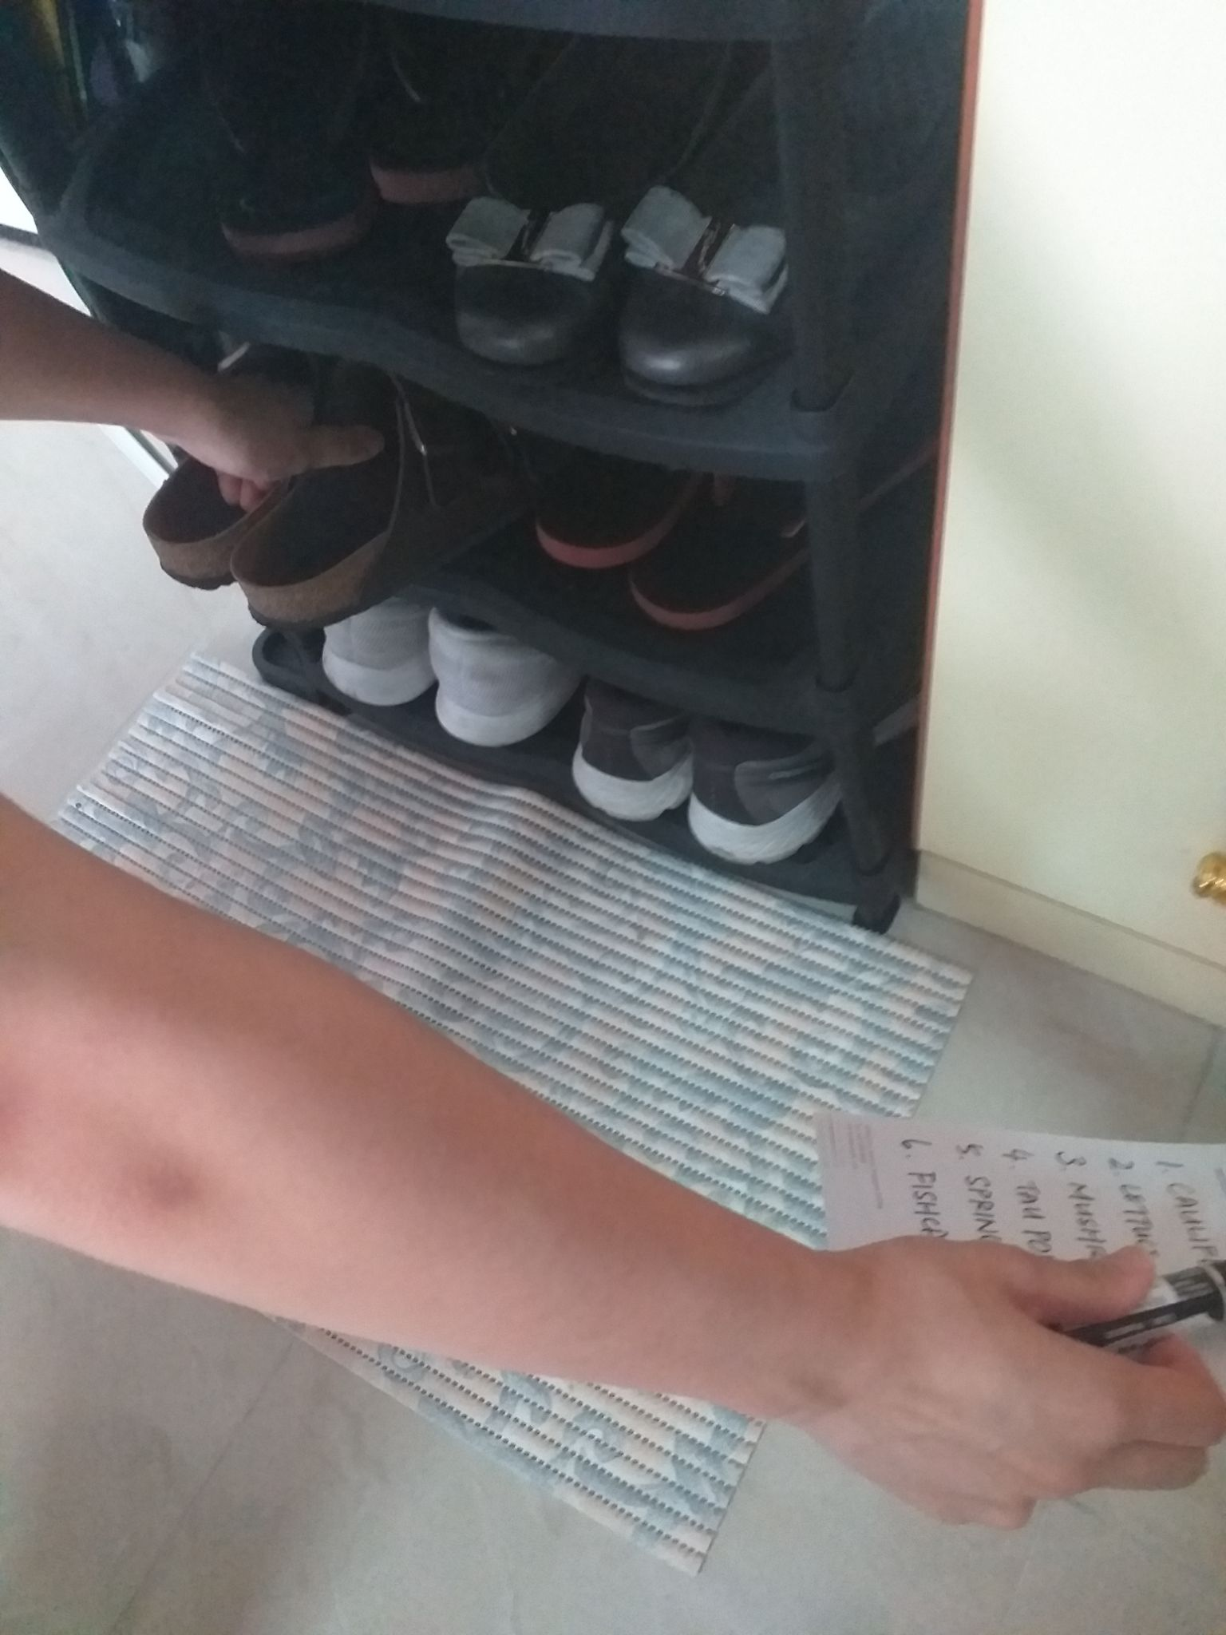

Slide 6
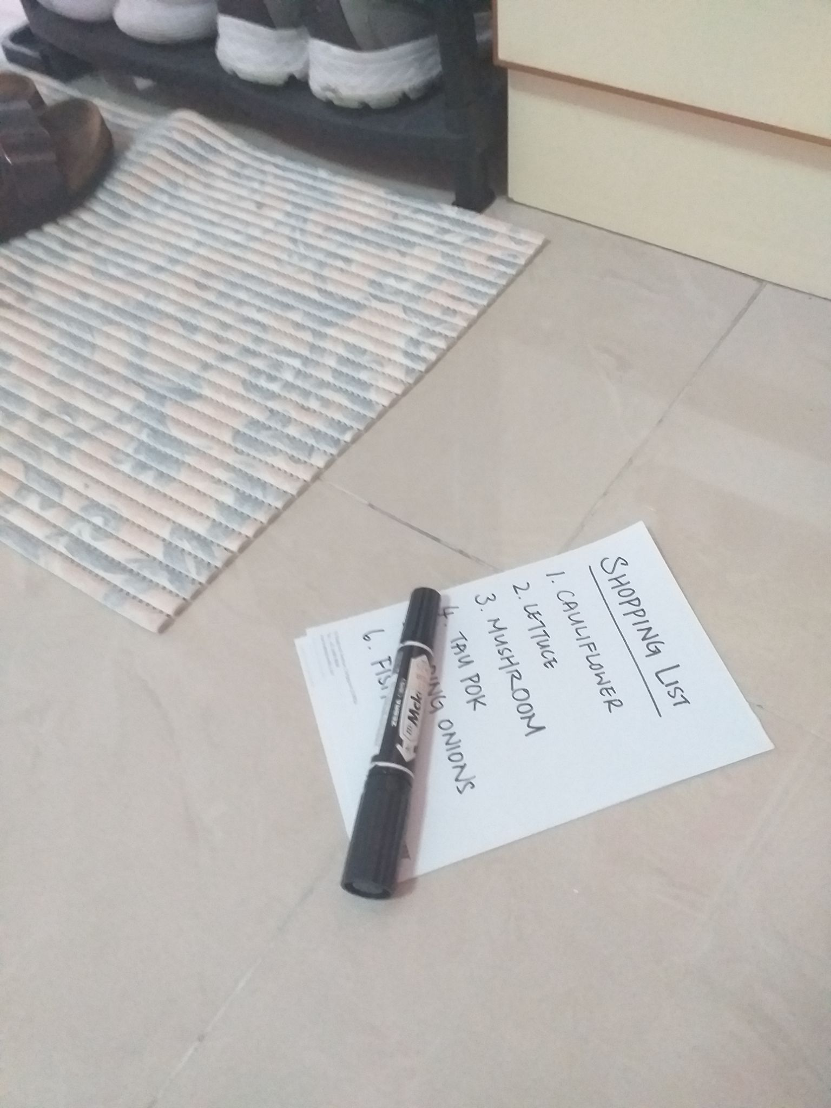

Slide 7
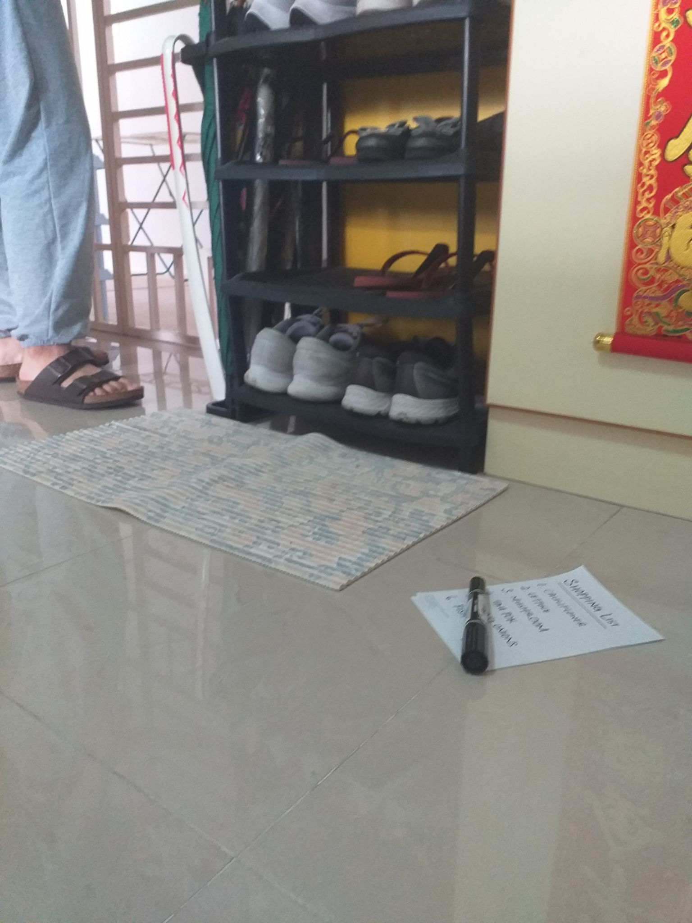

Slide 8
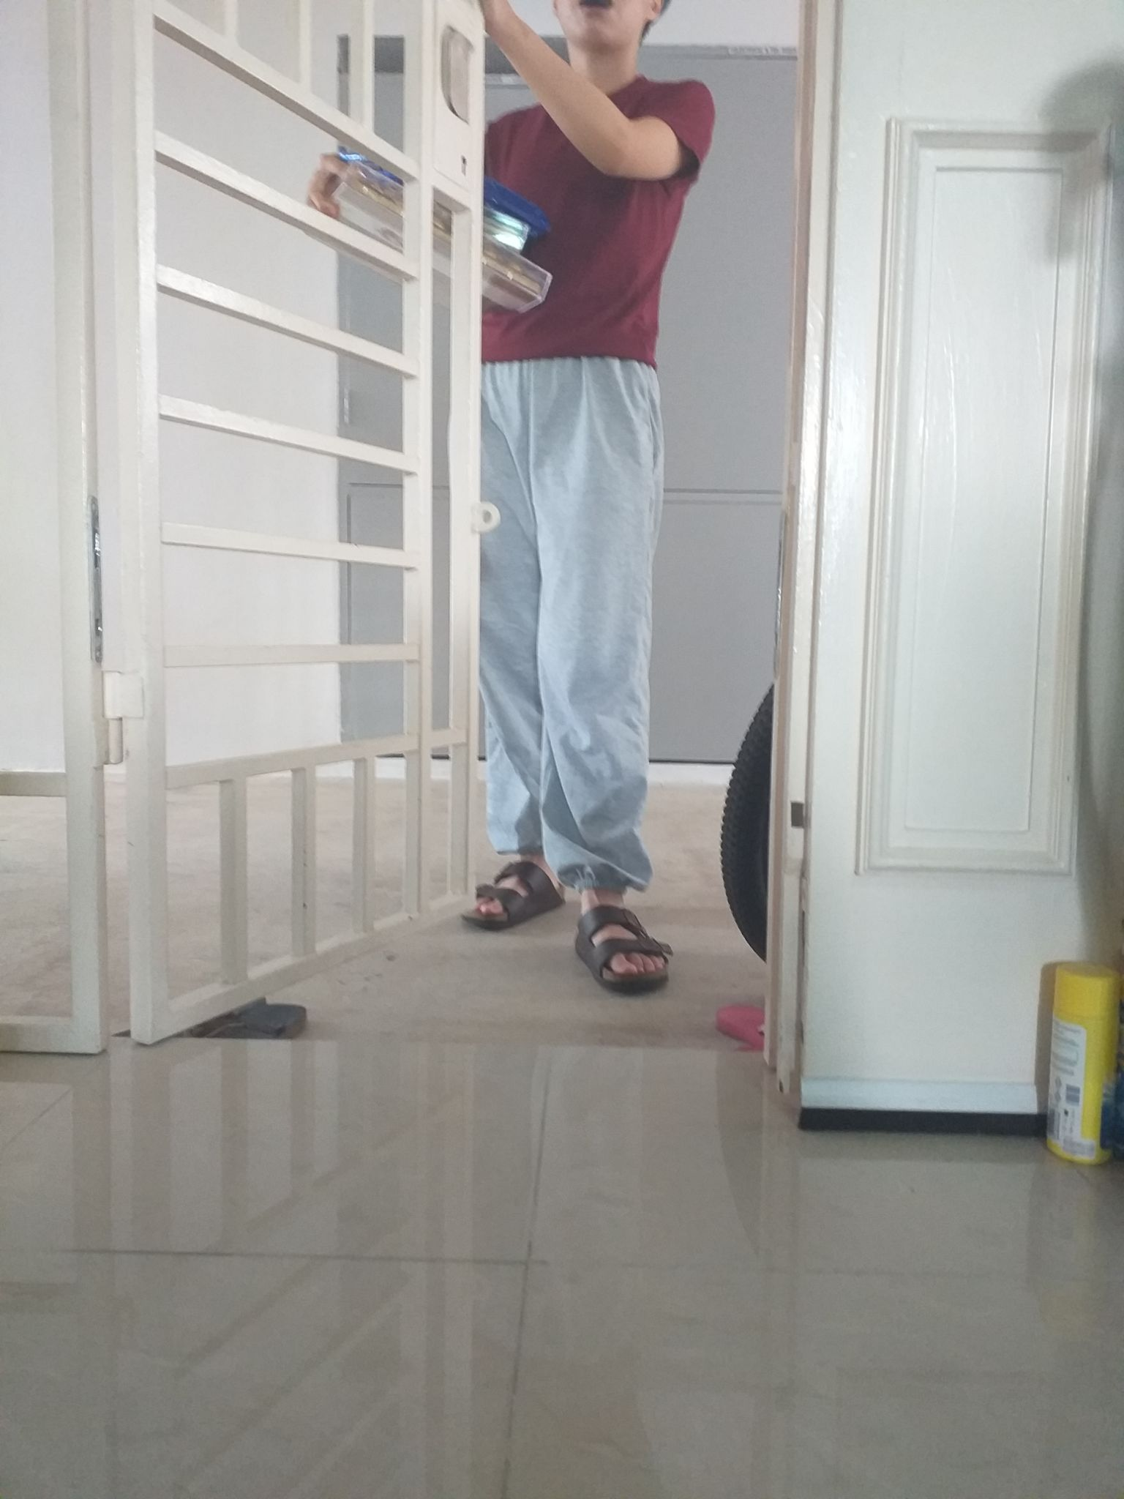

Slide 9
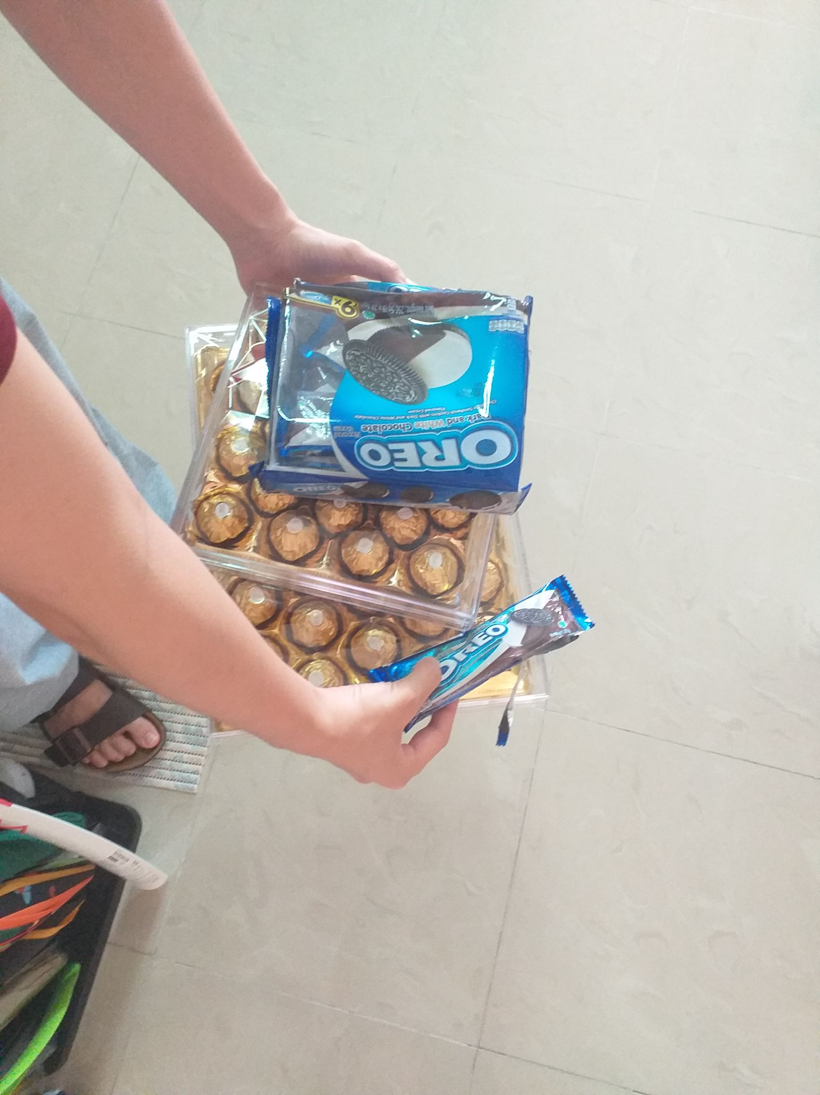

Slide 10
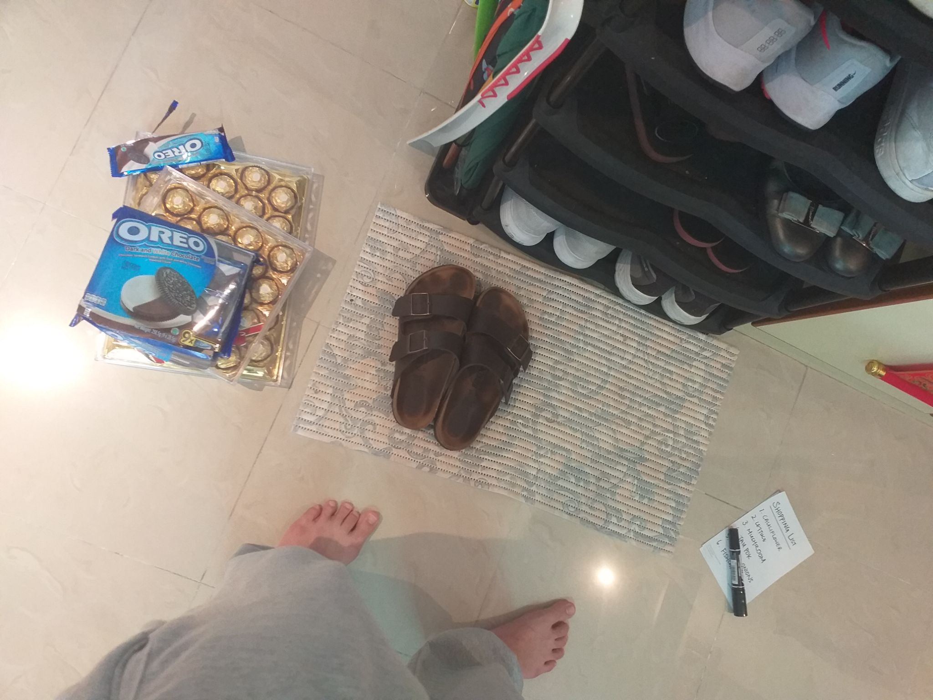

Slide 11
